Slide 1
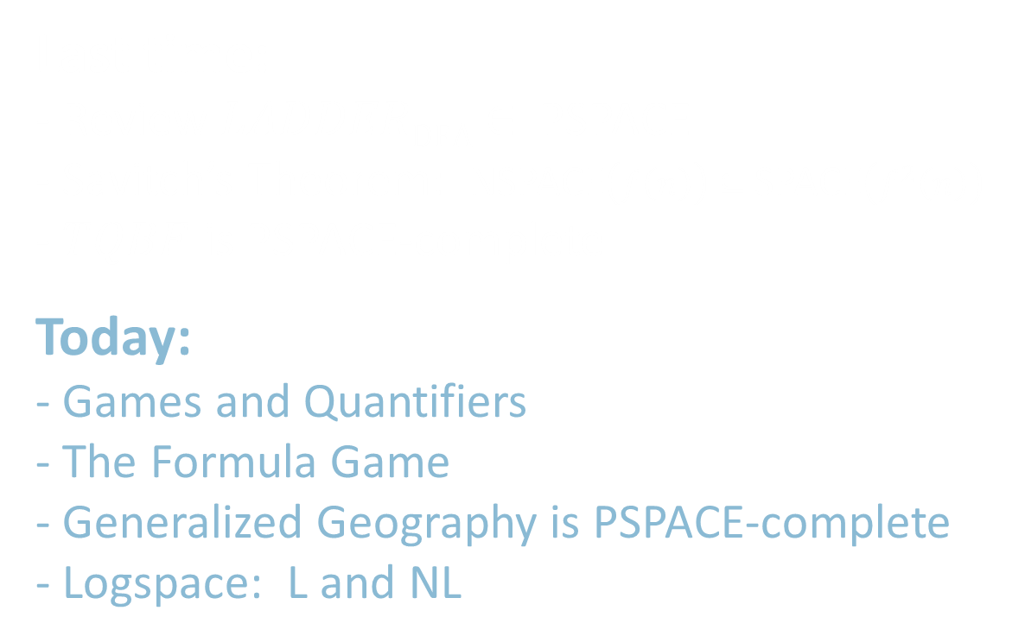
18.404/6.840 Lecture 19
Last time:
- Review $LADDER\text{DFA}$ $∈$ PSPACE
- Savitch’s Theorem: NSPACE$\left(f\left(n\right)\right)⊆$SPACE$\left(f^{2}\left(n\right)\right)$
- $TQBF$ is PSPACE-complete
Today:
- Games and Quantifiers
- The Formula Game
- Generalized Geography is PSPACE-complete
- Logspace: L and NL

Slide 2
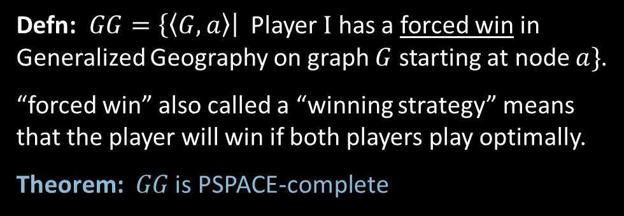
Games and Complexity
Geography game
Kalamazoo
New York
Kansas
Boston
San
Francisco
Oregon
Nebraska
Generalized Geography Game
Played on any directed graph.
Players take turns picking nodes that form a simple path.
The first player stuck loses.
Arkansas
Oklahoma
Assume two players:
Player I and Player II
Alaska
Defn: $GG=\left\{〈G,a〉\right|$Player I has a forced win in Generalized Geography on graph $G$ starting at node $a\}$.
“forced win” also called a “winning strategy” means that the player will win if both players play optimally.
Theorem: $GG$ is PSPACE-complete
Players take turns picking places that start with the letter which ended the previous place. No repeats allowed.
The first player stuck (= cannot move) loses.
Notes:
aka “Name Game” and others in wikipedia

Slide 3


Games and Quantifiers
$$ψ$$
The Formula Game
Given QBF $φ=∃x_{1} ∀x_{2} ∃x_{3} ⋯\left(∃/∀\right)x_{k} \left[ \left( ⋯\right)∧⋯∧\left( ⋯\right) \right]$
There are two Players “$∃$” and “$∀$”.
Player $∃$ assigns values to the $∃$-quantified variables.
Player $∀$ assigns values to the $∀$-quantified variables.
The players choose the values according to the order of the quantifiers in $φ$.
After all variables have been assigned values, we determine the winner:
Player $∃$ wins if the assignment satisfies$ψ$.
Player $∀$ wins if not.
Claim: Player $∃$ has a forced win in the formula game on $φ$ iff $φ$ is True.
Therefore $\left\{〈φ〉\right|$Player $∃$ has a forced win on $φ\}=TQBF$.
Next: show$TQBF≤_{P}GG$.

Slide 4
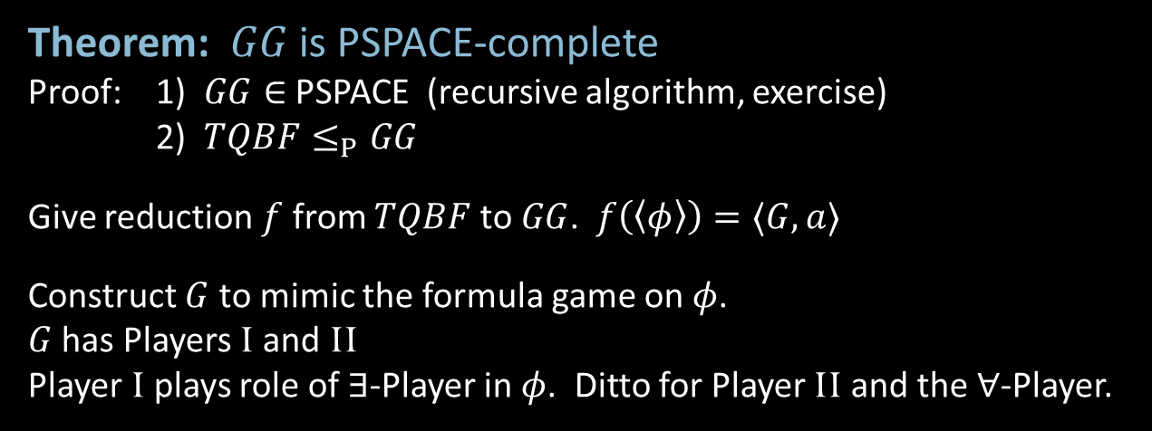



$GG$ is PSPACE-complete
Theorem: $GG$ is PSPACE-complete
Proof: 1) $GG∈$PSPACE (recursive algorithm, exercise)
2) $TQBF≤_{P}GG$
Give reduction $f$ from $TQBF$ to $GG$. $f\left(〈φ〉\right)=〈G,a〉$
Construct $G$ to mimic the formula game on $φ$.
$G$ has Players I and II
Player I plays role of $∃$-Player in $φ$. Ditto for Player II and the $∀$-Player.
$φ=∃x_{1} ∀x_{2} ∃x_{3} ⋯\left(∃/∀\right)x_{k} \left[ \left( ⋯\right)∧⋯∧\left( ⋯\right) \right]$
$$f$$
assume in cnf
$$G=$$

Slide 5


































Constructing the $GG$graph $G$
Illustrate construction by example
Say $φ=∃x_{1} ∀x_{2} ∃x_{3} ⋯ ∀x_{k} [ ( x_{1}∨\overline{x_{2}}∨x_{3} )∧(\overline{x_{1}}∨\overline{x_{2}}∨x_{4})∧⋯∧( ⋯) ]$
$$G=$$
$$∃$$
I = $∃$
II = $∀$
$$a$$
$$c_{1}$$
$$a$$
$$c_{2}$$
$$c_{k}$$
True
$$∀$$
False
$$x_{1}$$
$$∃$$
$$∃$$
$$∀$$
$$∃$$
$$∃$$
Endgame
$∃$ should win if assignment satisfied all clauses
$∀$ should win if some unsatisfied clause
Implementation
$∀$ picks clause node claimed unsatisfied
$∃$ picks literal node claimed to satisfy the clause
liar will be stuck
$$x_{2}$$
$$∀$$
$$∀$$
$$∀$$
$$c_{1}$$
$$c_{1}$$
$$c_{2}$$
$$⋯$$
$$c_{k}$$
$$∀$$
$$∀$$
$$c_{2}$$
$$∃$$
$$x_{1}$$
$$x_{3}$$
$$\overline{x_{1}}$$
$$x_{4}$$
$$⋮$$
$$x_{1}$$
$$\overline{x_{2}}$$
$$\overline{x_{1}}$$
$$\overline{x_{2}}$$
$$∃$$
$$x_{m}$$

Slide 6


Slide 7



Log space
To define sublinear space computation, do not count input as part of space used.
Use 2-tape TM model with read-only input tape.
Defn: L = SPACE$\left(\log{n}\right)$
NL = NSPACE$\left(\log{n}\right)$
Log space can represent a constant
number of pointers into the input.
Examples
$\left\{ww^{ℛ} \right| w∈Σ^{∗}\}∈$ L
$PATH∈$ NL
read-only input tape does not count towards space used
count cells used here
read/write work tape
$$O\left(\log{n}\right)$$
ababbaaaaaaaaaabbaba
Work tape tracks corresponding locations
in the input tape.
NL
Nondeterministically select the nodes
of a path connecting $s$ to $t$.
L
L = NL? Unsolved

Slide 8





Log space properties
Theorem: L $⊆$ P
Proof: Say $M$ decides $A$ in space $O\left(\log{n}\right)$.
Defn: A configuration for $M$ on $w$ is $\left(q,p_{1},p_{2},t\right)$ where $q$ is a state,
$p_{1}$ and $p_{2}$ are the tape head positions, and $t$ is the tape contents.
The number of such configurations is $\left|Q\right|×n×O\left(\log{n}\right)×d^{O\left(\log{n}\right)}={O(n}^{k})$ for some $k$.
Therefore $M$ runs in polynomial time.
Conclusion: $A∈$ P
Theorem: NL $⊆$ $\text{SPACE}\left(\log^{2}{n}\right)$
Proof: Savitch’s theorem works for log space
$$p_{1}$$
$$q$$
$$p_{2}$$
$$t$$

Slide 9






NL properties
Theorem: NL $⊆$ P
Proof: Say NTM $M$ decides $A$ in space $O\left(\log{n}\right)$.
Defn: The configuration graph $G_{M,w}$ for $M$ on $w$ has
nodes: all configurations for $M$ on $w$
edges: edge from $c_{i}→c_{j}$ if $c_{i}$ can yield $c_{j}$ in 1 step.
Claim: $M$ accepts $w$ iff the configuration graph $G_{M,w}$ has a path from $c_{start}$ to $c_{accept}$
Polynomial time algorithm $T$ for $A$:
$T=$ “On input $w$
1. Construct the $G_{M,w}$.
2. Accept if there is a path from $c_{start}$ to $c_{accept}$.
Reject if not.”
$$G_{M,w}$$
$$c_{start}$$
$$c_{accept}$$
$$c_{i}$$
$$c_{j}$$
P
NL
L = P? Unsolved
L

Slide 10

Quick review of today
The Formula Game
Generalized Geography is PSPACE-complete
Log space: L and NL
Configuration graph
NL $⊆$ P

